Slide 1
RMO body size
28.10.2021

Slide 2
Intraspecific body sizes
BodySize (head and length) ~ Year + DOY + Intraspecific density + site

Slide 3
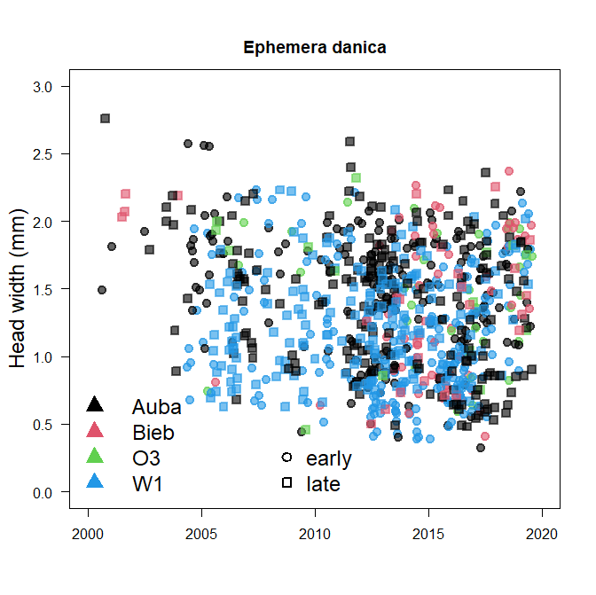
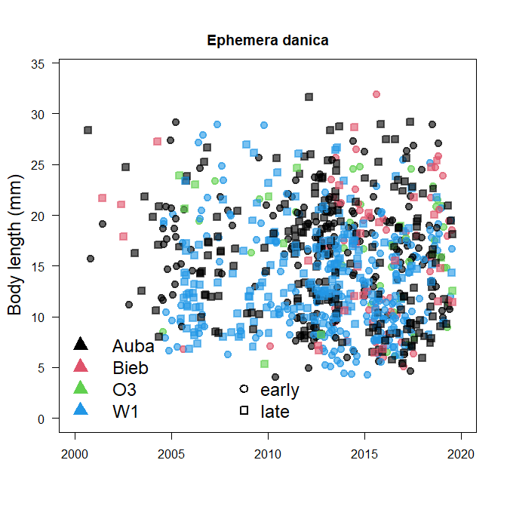
Sig effects: Yr & Site
Sig effects: Yr & Site

Slide 4
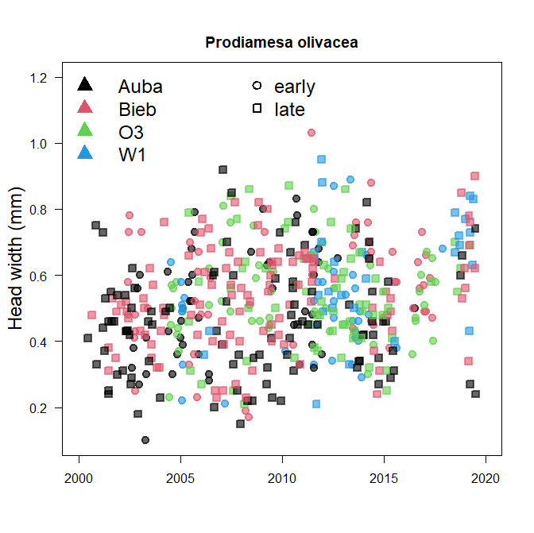
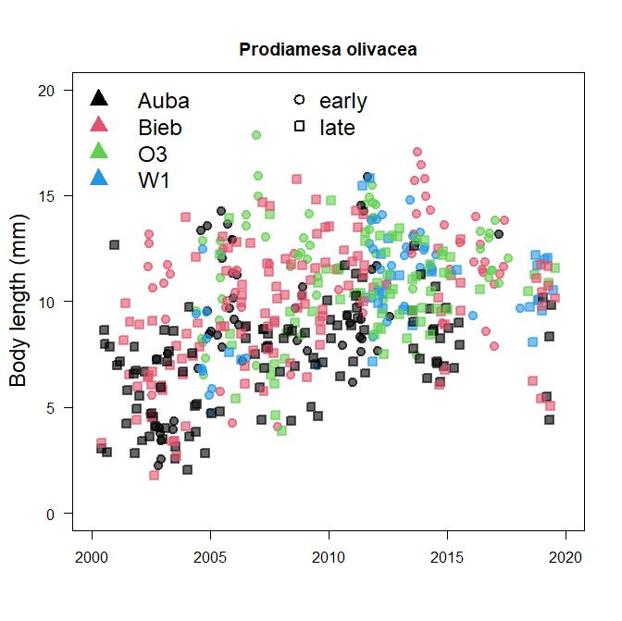
Sig effects: Yr & Site
Sig effects: Yr, Site, DOY, density

Slide 5
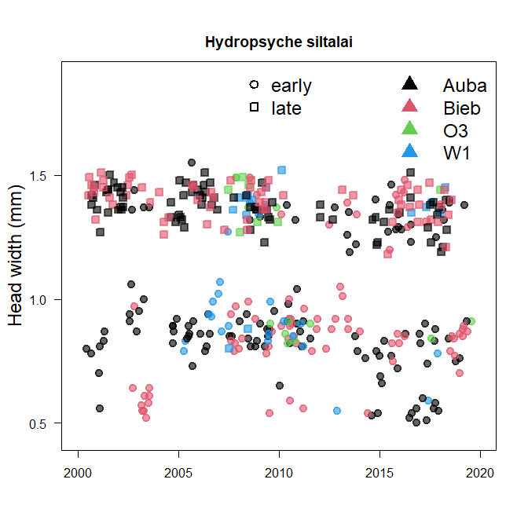
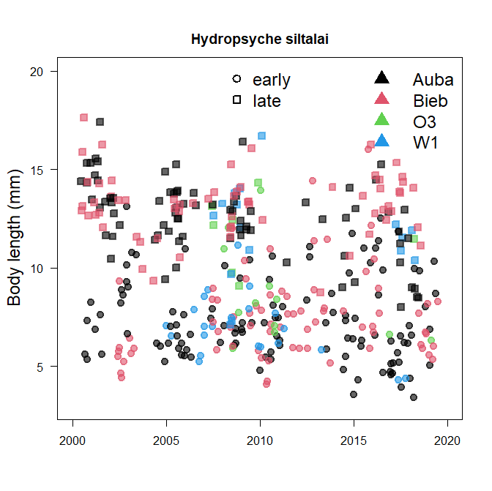
Sig effects: DOY, density
Sig effects: Site, DOY

Slide 6
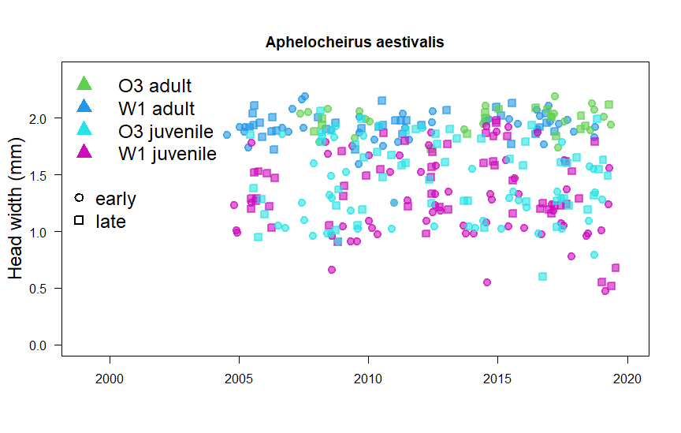
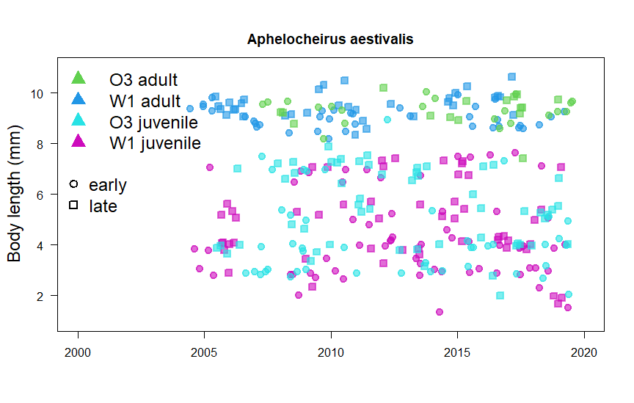
Sig effects: DOY, Adult/Juvenile, Site
Sig effects: DOY, Adult/Juvenile, Site

Slide 7
Interspecific body sizes -CWM
lmer(CWM ~ + DOY + (1|site)
Sig effects: + yr and + DOY

Slide 8
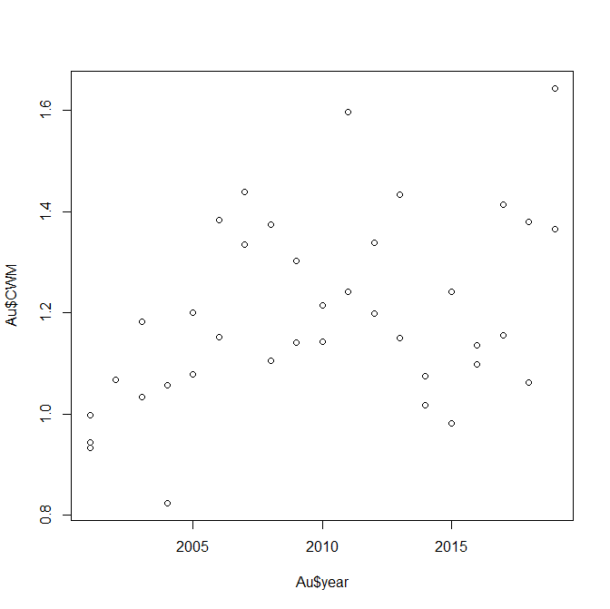
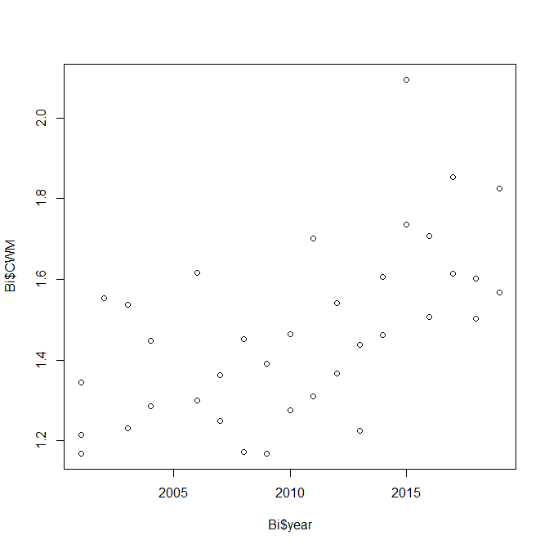
Aubach and Bieber CWMs

Slide 9
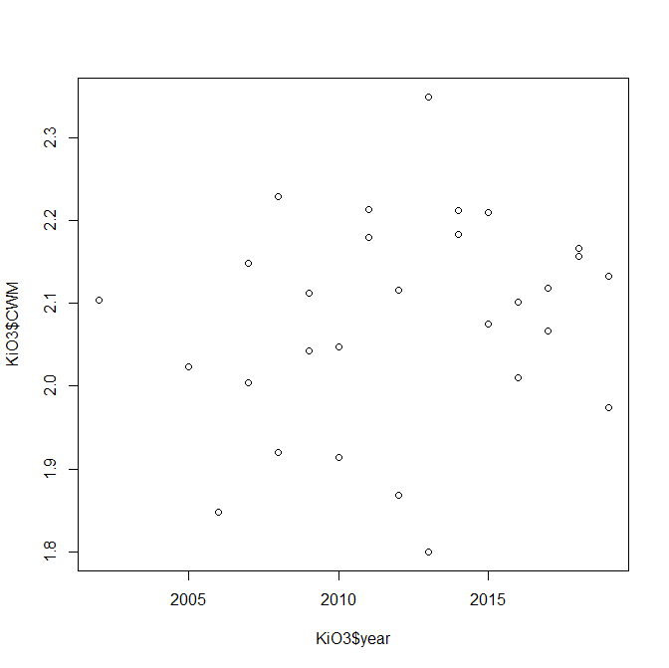
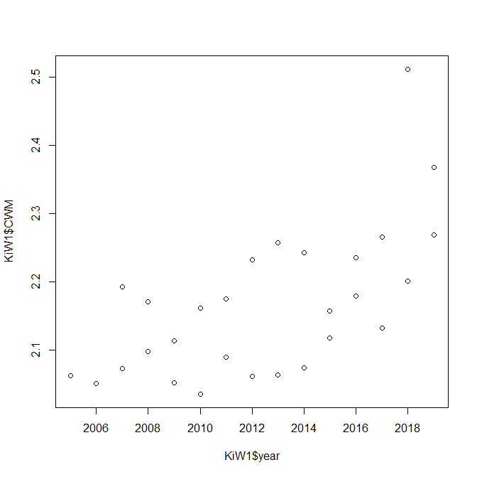
Kinzig CWMs

Slide 10
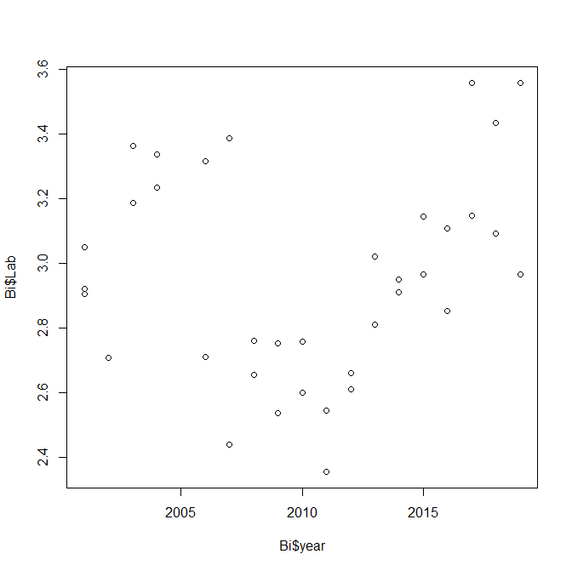
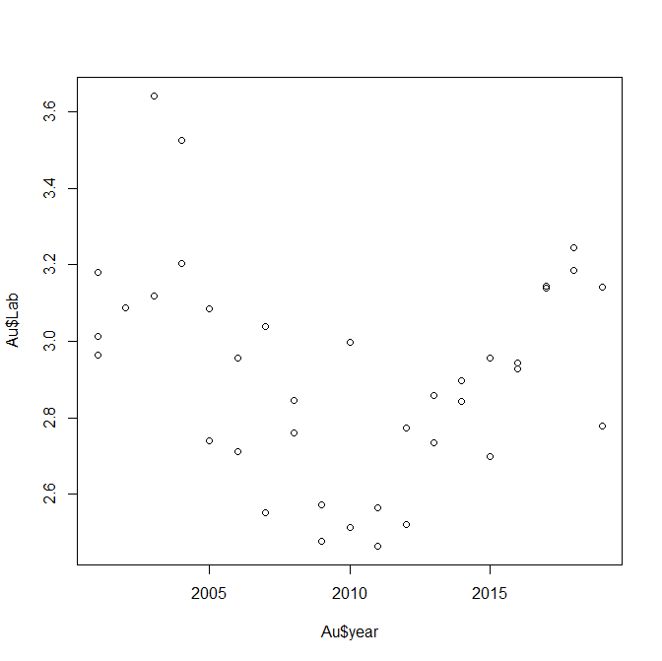
Aubach and Bieber Abundances

Slide 11
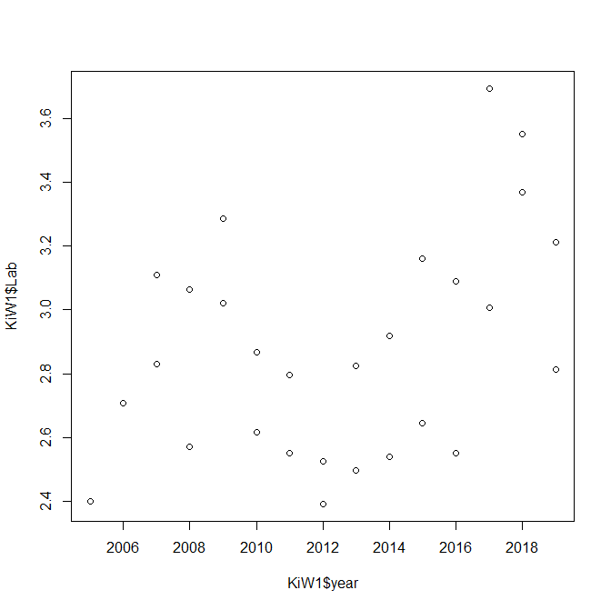
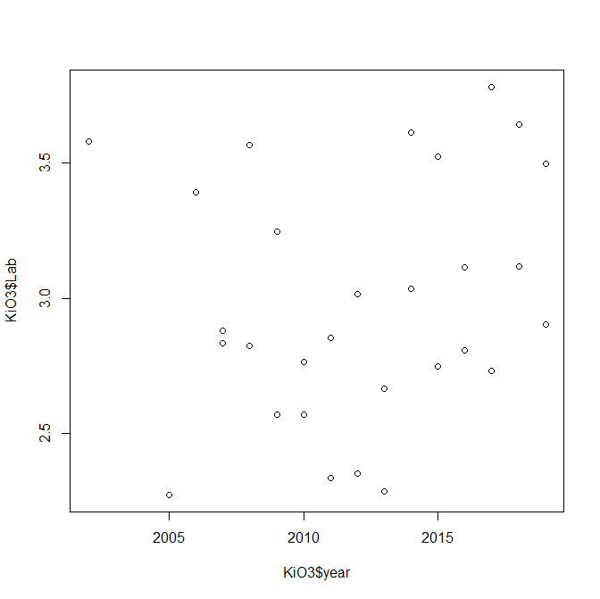
Kinzig Abundances

Slide 12
Interspecific body sizes- species level trends
Trend: gls(abundance ~ DOY + year)
lmer(Yr_Trend~ bodysize+ (1|site))
Sig effect: body size

Slide 13
